Slide 2
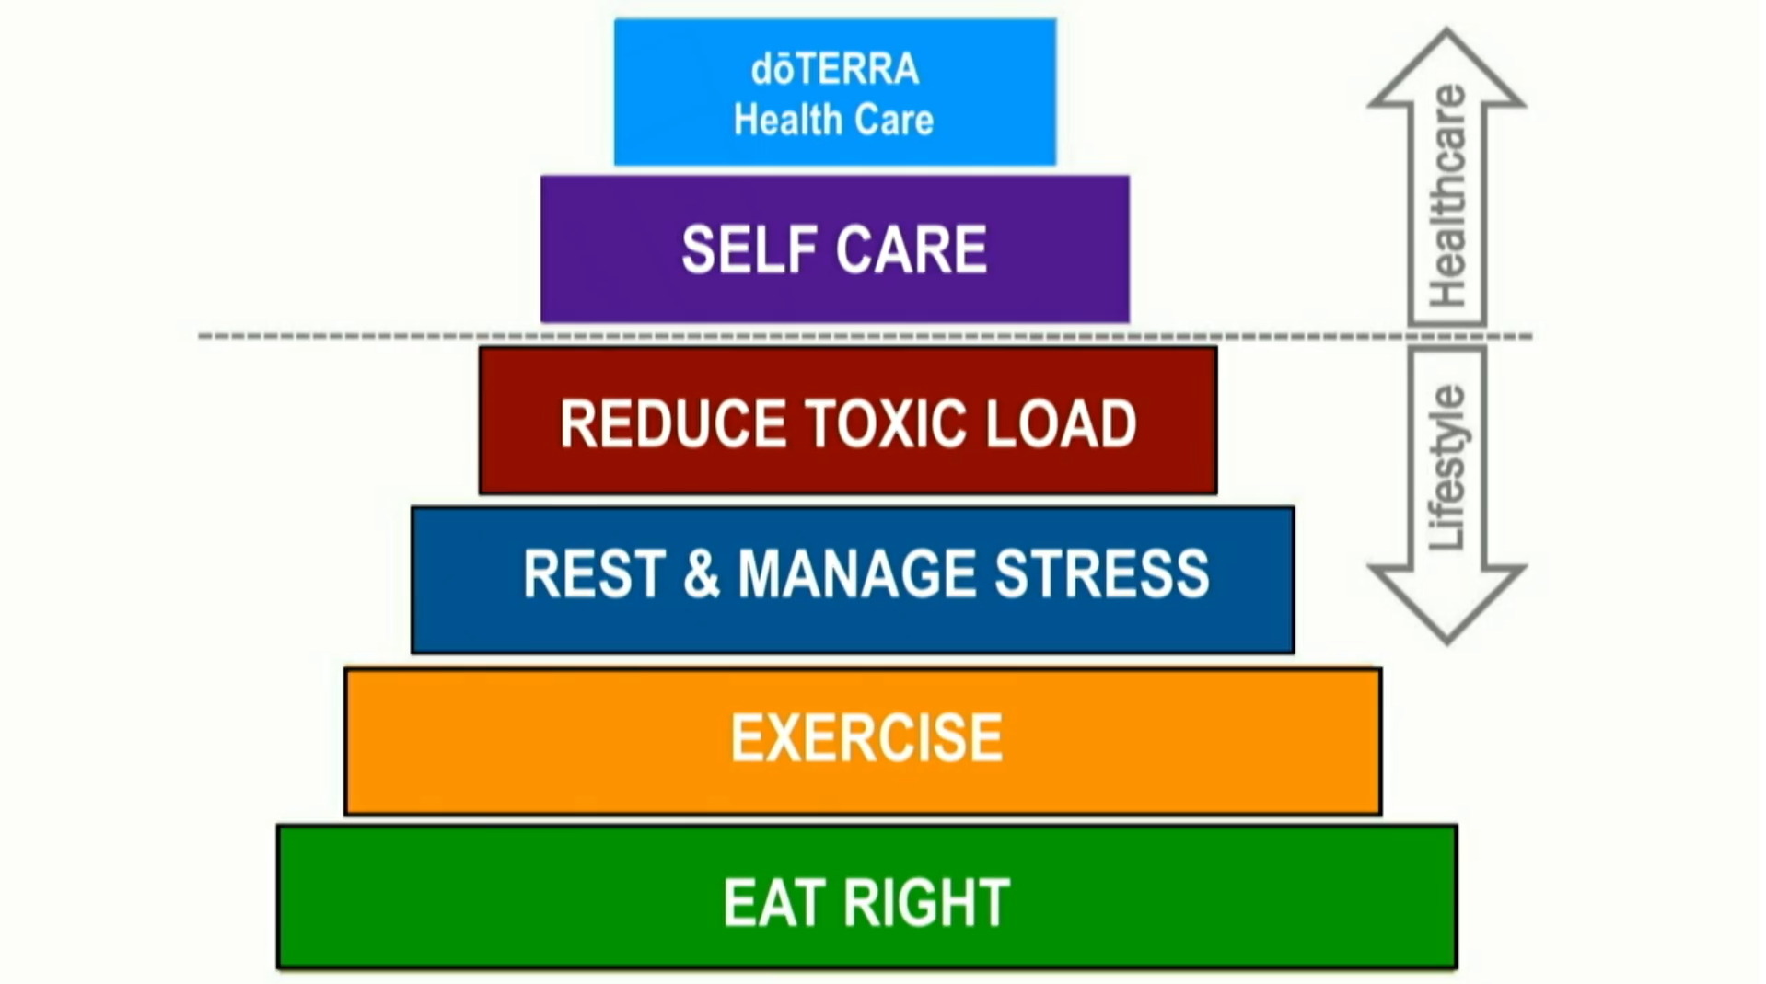
Wellness Pyramid

Slide 3
Wellness Pyramid
Notes:
PB Assist
Restore balance to beneficial intestinal flora, Supports healthy immunity, Specialized delivery (delivered intact for strong colonization)
Intestinal flora are very susceptible to toxicity
TerraZyme
Supports the healthy digestion of foods, Promotes production of metabolic enzymes by your body
Enzymes drive vitamin and mineral activity. Vitamins and minerals drive enzyme activity. YOU NEED BOTH!
This is food (digestive) enzymes, not metabolic enzymes. Your cells can manufacture one or the other efficiently so to increase metabolic enzymes, you need to make sure your diet is rich in food (digestive) enzymes! And as we learned before, essential oils interact with enzymes.

Slide 4
Wellness Pyramid

Slide 5
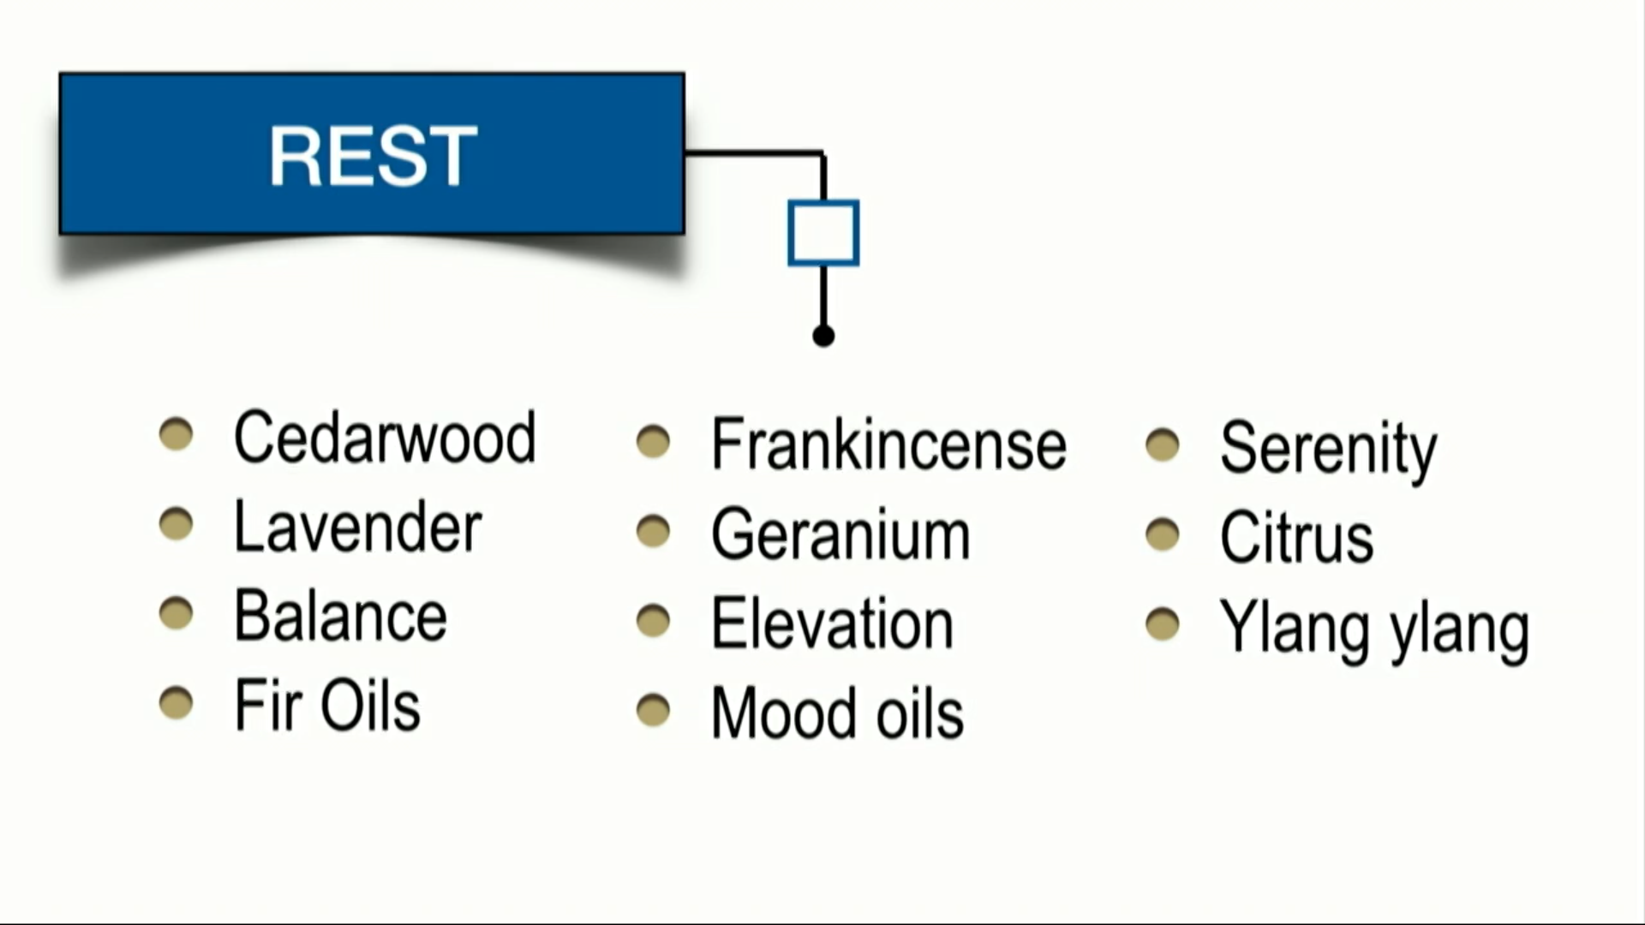
Wellness Pyramid
Notes:
Rest isn’t about just sleeping well. It’s also about how we reduce metabolic and cellular stress on the body; controlling emotional responses

Slide 6
Wellness Pyramid
Notes:
Citrus oils support the body’s natural ability to cleanse, detoxify and protect.

Slide 7
THE SCIENCE
Notes:
High in Limonene, which increases glutathione levels in critical tissues such as the liver and central nervous system.

Slide 8
Wellness Pyramid

Slide 9
THE SCIENCE

Slide 10
THE SCIENCE

Slide 11
THE SCIENCE
Notes:
Wild orange: Monoterpenes
Clove, Cinnamon: Phenols – destroy membranes
Cinnamon: Aldehydes – inhibit communication (active defense mechanism used by the body)
Eucalyptus, Rosemary: Alcohols – support immune cell function

Slide 12
Wellness Pyramid

Slide 13
THE DAILY ROUTINE

Slide 14
THE DAILY ROUTINE

Slide 15
THE DAILY ROUTINE

Slide 16
THE DAILY ROUTINE

Slide 17
THE EASY ADD KIT
Daily Habits Kit
$185 (150PV)
Wellness is a combination of lifestyle and health. Daily habits make all the difference! These products are recommended for daily use in order to achieve and maintain a healthy lifestyle.
Notes:
Wellness is a combination of lifestyle and health. Daily habits make all the difference! This kit includes products recommended for daily use in order to achieve and maintain a healthy lifestyle.
doTERRA On Guard® (5 mL)—Use to support immunity*
doTERRA Balance® (5 mL)—Use to lessen stress and anxious feelings
Frankincense (5 mL)—Use to promote cellular health*
Lemon (5 mL)—Add to water to help release toxins*
Lavender (5 mL)—Use to assist with restful sleep and stress management
Deep Blue® Rub—Use topically where needed before and after your workout
doTERRA Lifelong Vitality Pack®: xEO Mega®, Alpha CRS®+, Microplex VMz®—Maximize your daily nutrient intake
DigestZen® Supplements: DigestZen TerraZyme®, PB Assist®+—Support digestion and optimize your gastrointestinal tract*

Slide 18
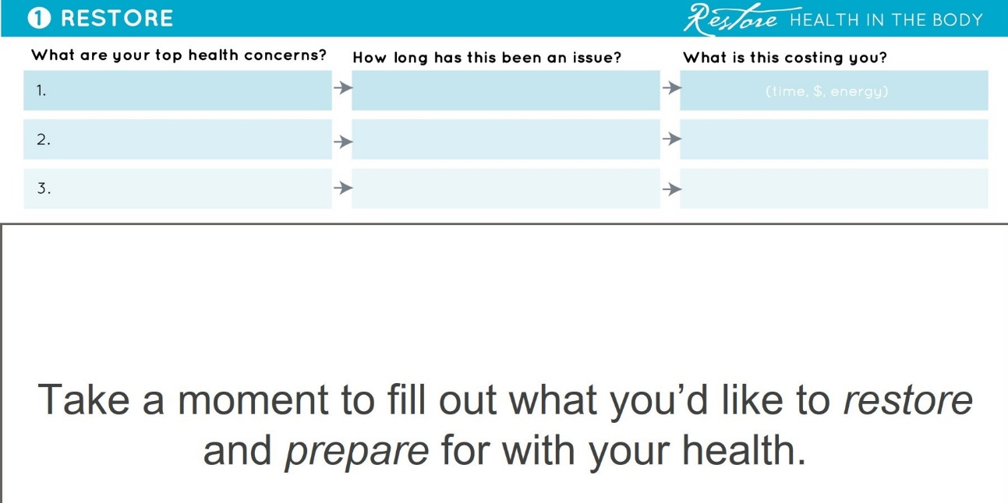
HOW Do I Get Started?
Top Health Priorities
Retail or Wholesale
Fee or No Fee
Big or Small

Slide 19
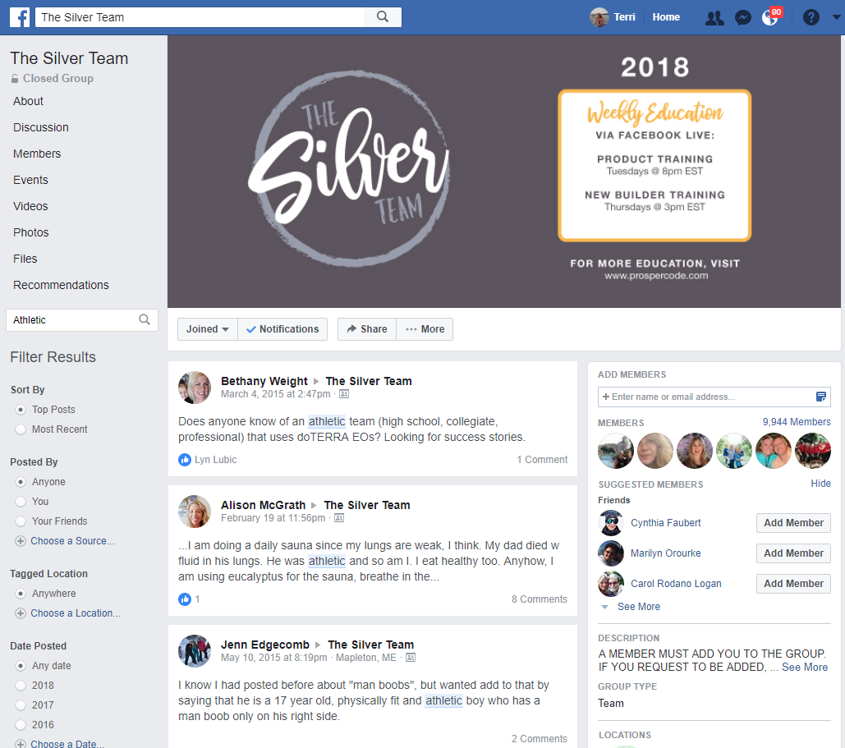
BENEFITS OF MEMBERSHIP
Thriving Wellness Community of Likeminded, Like-hearted People
Solutions at Your Fingertips!
Access to Scientific Studies and Peer-Reviewed Research
FREE Weekly Trainings Programs
Notes:
When you become a member of our team, you get access to exclusive benefits.
You join thousands of other likeminded, like-hearted people who join you on your journey!
You get access to The Silver Team, a closed Facebook group with years of solutions from these people who use the dōTERRA® products…I love that we all get to learn together. No one has to recreate the wheel!
DōTERRA® is an education based product and the company is committed to providing information about safe and effective uses, studies which support the therapeutic claims made, and medical practitioners who USE THESE SAME PRODUCTS in their homes too!
And of course, there are many classes and topics available in person and online to continue your journey of discovery!

Slide 20
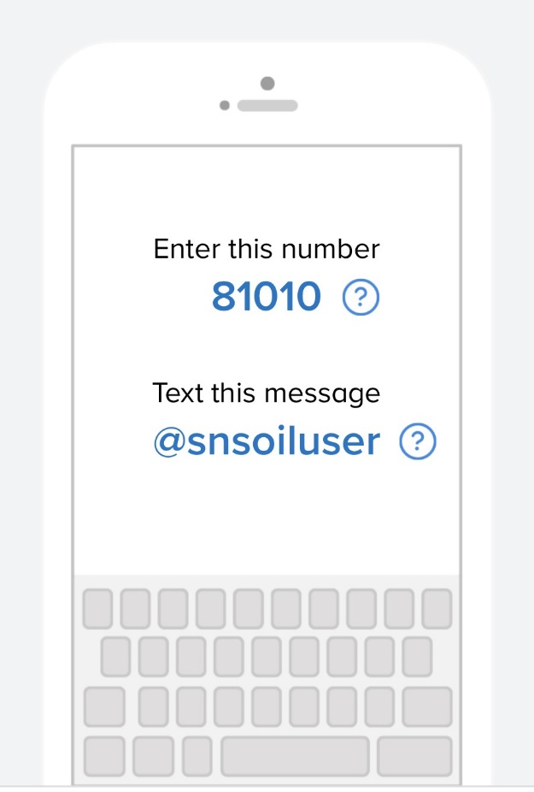
GET CONNECTED
Remind Notifications for Product Usage and Happenings
www.remind.com/join/snsoiluser

Slide 21
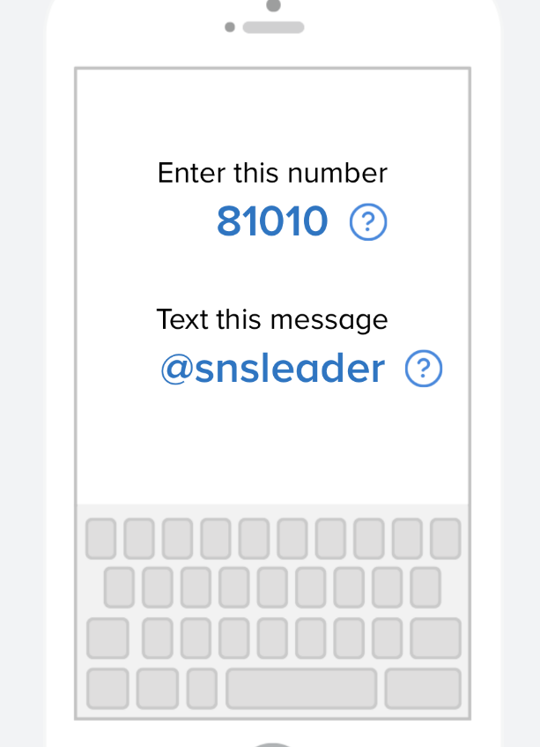
GET CONNECTED
Remind Notifications for
Business & Leadership Trainings
and Personal Development Opportunities
www.remind.com/join/snsleader

Slide 22
Visit my Eventbrite Site for Full Class Listing: http://simplynaturalseminars.eventbrite.com/
Mailing list for event and class notifications:
http://eepurl.com/K4uQf
Facebook Page: Simply Natural Solutions with TERRI PACE
https://www.facebook.com/simplynaturalnews/
YouTube Channel:
https://www.youtube.com/c/TerriPaceSNS
Instagram: Terri.Pace
https://www.instagram.com/terri.pace/
Email: simply.natural@optimum.net

Slide 23
THANK YOU FOR ATTENDING!
An Introduction to Natural Solutions
Terri Pace, Certified Holistic Health Coach & dōTERRA® Wellness Advocate

