Slide 1
Basic business building
Where do you want to be in 2022?
How to identify what your customer will do?
Notes:
Basic business building Where do you want to be in 2015? PERSONALITY SHAPES.

Slide 2
Personality Shapes
Circles
Squares
Squiggles
Triangles
Notes:
Circles, squares, squiggles, triangles

Slide 3
Circles – Supporter - Amiable
Needs to know why and how
Dislikes risk, pressure or conflict
Caregiver/helpers
Fun-loving
Enjoy being with people
Over-commit (hate to say "no")
Worry too much
Try too hard to please
Notes:
Circles

Slide 4
Squares - Analyst
Don't like "touchy feely". Aren't used to having fun and don't have much time to waste!
Loyal
Hardworking
Very organized
Not fond of change
Not the best team player/prefer to work alone
Prone to view "fun" as unnecessary or as a luxury
Detail Orientated
Notes:
Squares

Slide 5
Squiggles
Artistic/Creative – ideas people
Dreamers
Quick decision maker
Enthusiastic
High energy
Flexible/spontaneous will
Easily distracted
Often act or speak without thinking
Notes:
Squiggles

Slide 6
Triangles – Controller - Driver
Take charge and move fast
Bottom line/efficient
Confident
Very competitive
Love to debate and argue
Impatient/outspoken
Notes:
Triangles

Slide 7
Personality Shapes
Analytical
(Task Orientated)
Listen
(Introvert)
Talk
(Extrovert)
Intuitive
(People Orientated)
Notes:
Circles, squares, squiggles, triangles

Slide 8
How to know your CIRCLE customer
Applies to your very first and every appointment
Does not mind if you arrive10 minutes early or late
Meet any place for 1 hour or more
Notes:
Triangles

Slide 9
How to know your SQUARE customer
Always arrive on time
Always meet at their place
Present facts and figures
No immediate decision at meeting usually
Notes:
Triangles

Slide 10
How to know your SQUIGGLE customer
Always arrive on time
Usually public meeting, but may be their place
Meeting for 30 minutes to 1 hour
Immediate decision at meeting usually
Notes:
Triangles

Slide 11
How to know your TRIANGLE customer
Always arrive10 minutes early
Always a formal meeting at their place
Meeting for 20 minutes maximum
Immediate decision at meeting usually
Notes:
Triangles

Slide 12
dōTERRA DIFFERENT USE OF SYMBOLS
Notes:
Different in doTERRA

Slide 13
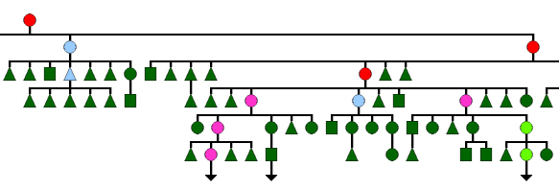
dōTERRA Back Office Graphic Tree
TRIANGLE – Not on LRP – Only orders occasionally
SQUARE – On LRP but orders less than 100PV
CIRCLE – On LRP and orders over 100PV
Notes:
Backoffice graphic tree. Triangle – orders occasionally. Square – less than 100PV LRP. Circle – 100PV LRP.

Slide 14
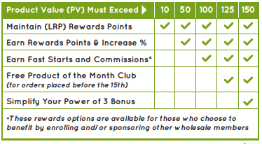
Why 100PV LRP?
Over 100PV per month gives all compensation to Wellness Advocate
Under 100PV only allows for Unilevel
Triangles block compensation
Notes:
Why 100PV LRP

Slide 15
Why order LRP between 1 - 15?
Option of Product of the month for 125PV – Announced on 1st Month
Up-line can calculate team volume before the end of the month
Notes:
LRP 1 - 15

Slide 16
16 – 28 of the month?
Can still order LRP
No Product of the month
Notes:
16 – 28 Month

Slide 17
After 28 of the month?
Must do a Standard Order – points still allocated.
Notes:
After 28 Month

Slide 18
Changing your order!!!!!
Not a good idea to change your order before the end of the month, once shipped
But, if you do HAVE to change your order keep it over 100 LRP – this keeps you as a circle and entitles you to compensation
Do not go back as a square (<100PV) and lose many dollars in bonuses
Notes:
Changing your order.

Slide 19
Where to from here?
BUILDING A TEAM
Notes:
Building a team

Slide 20
Starting to build?
You must be on 100PV LRP
You must have 3 team on 100PV LRP
Team OV must be 600PV
You 100PV
150PV
100PV
100PV
100PV
100PV
100PV
150PV
150PV
150PV
Notes:
Starting a team – Power of 3.

Slide 21
Where to from here?
WHAT WILL YOU DO NEXT?
Notes:
What will you do next?

Slide 22
Convert your customers to LRP!
As soon as you enrol them up (or contact an existing customer) do a Wellness Consult
The Wellness Consult is included in the Live booklet in the Enrolment Pack
Takes approximately one hour
Notes:
Changing your order.

Slide 23
Convert your customers to LRP!
Can be done in person (BEST!), by Zoom or by phone. Use the whole Live book
Use the question sheet provided so you can ask the right questions
Do a follow up Consult one month later
Notes:
Changing your order.

Slide 24
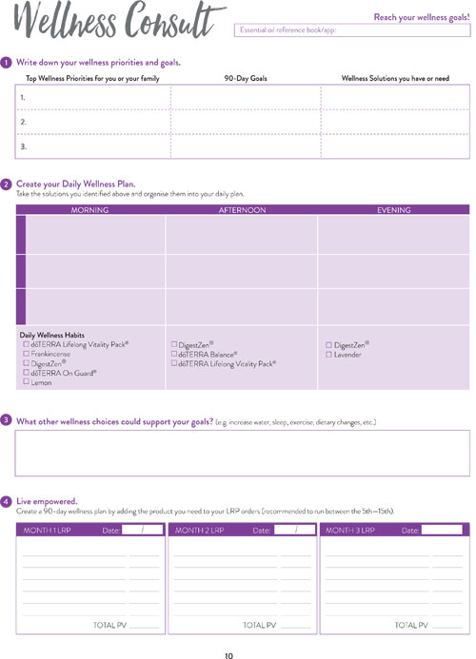
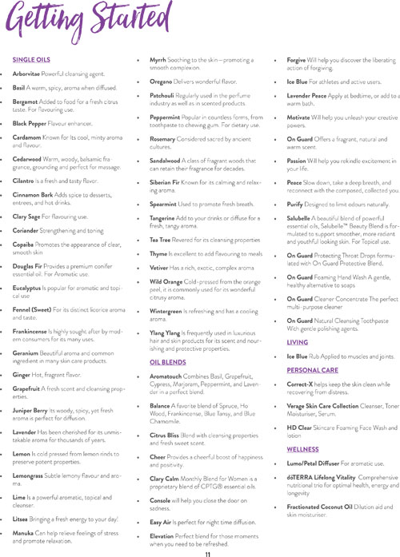
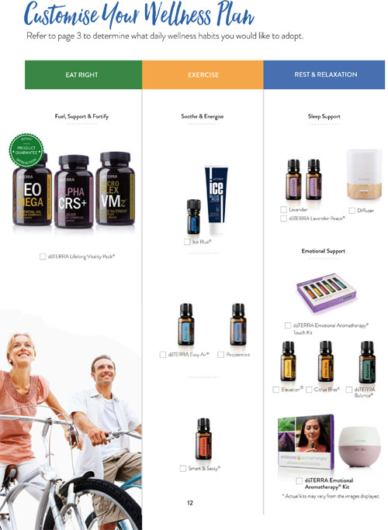
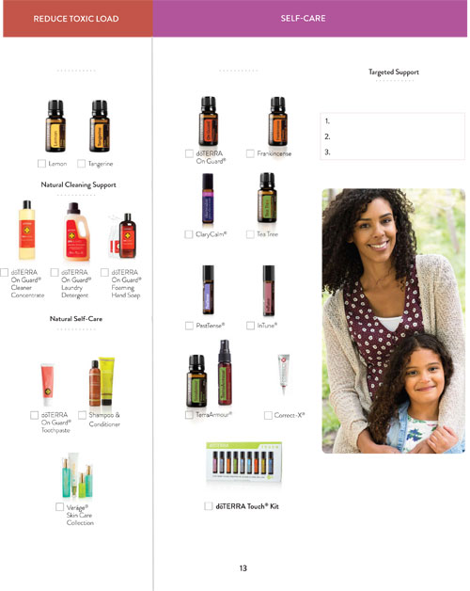
Wellness Consult

Slide 25
Now what?
JUST GO AND DO IT?
Notes:
What will you do next?

